Slide 1

Highlighting Women’s Accomplishments in the Tech Sector with
FemTech
Team Members: Milena Danadzhieva, Odette Gordon
Olivia Bugaj, Zara Agha

Slide 2
5:1
66%
6.3%
Is the ratio of men to women in engineering
Is the increase that Fortune 500 companies saw with at least three women in leading positions in ROI
Is the percentage of new hires from Black, indigenous, Latin, and multiracial women

Slide 3
Why FemTech ?
Positive media representation can be helpful in increasing self-esteem for people of marginalized groups (especially youth).
Interpersonal contact and exposure through media representation can assist in reducing stereotypes of underrepresented groups.
Representation in educational curricula and social media can provide validation and support, especially for youth of marginalized groups.

Slide 4
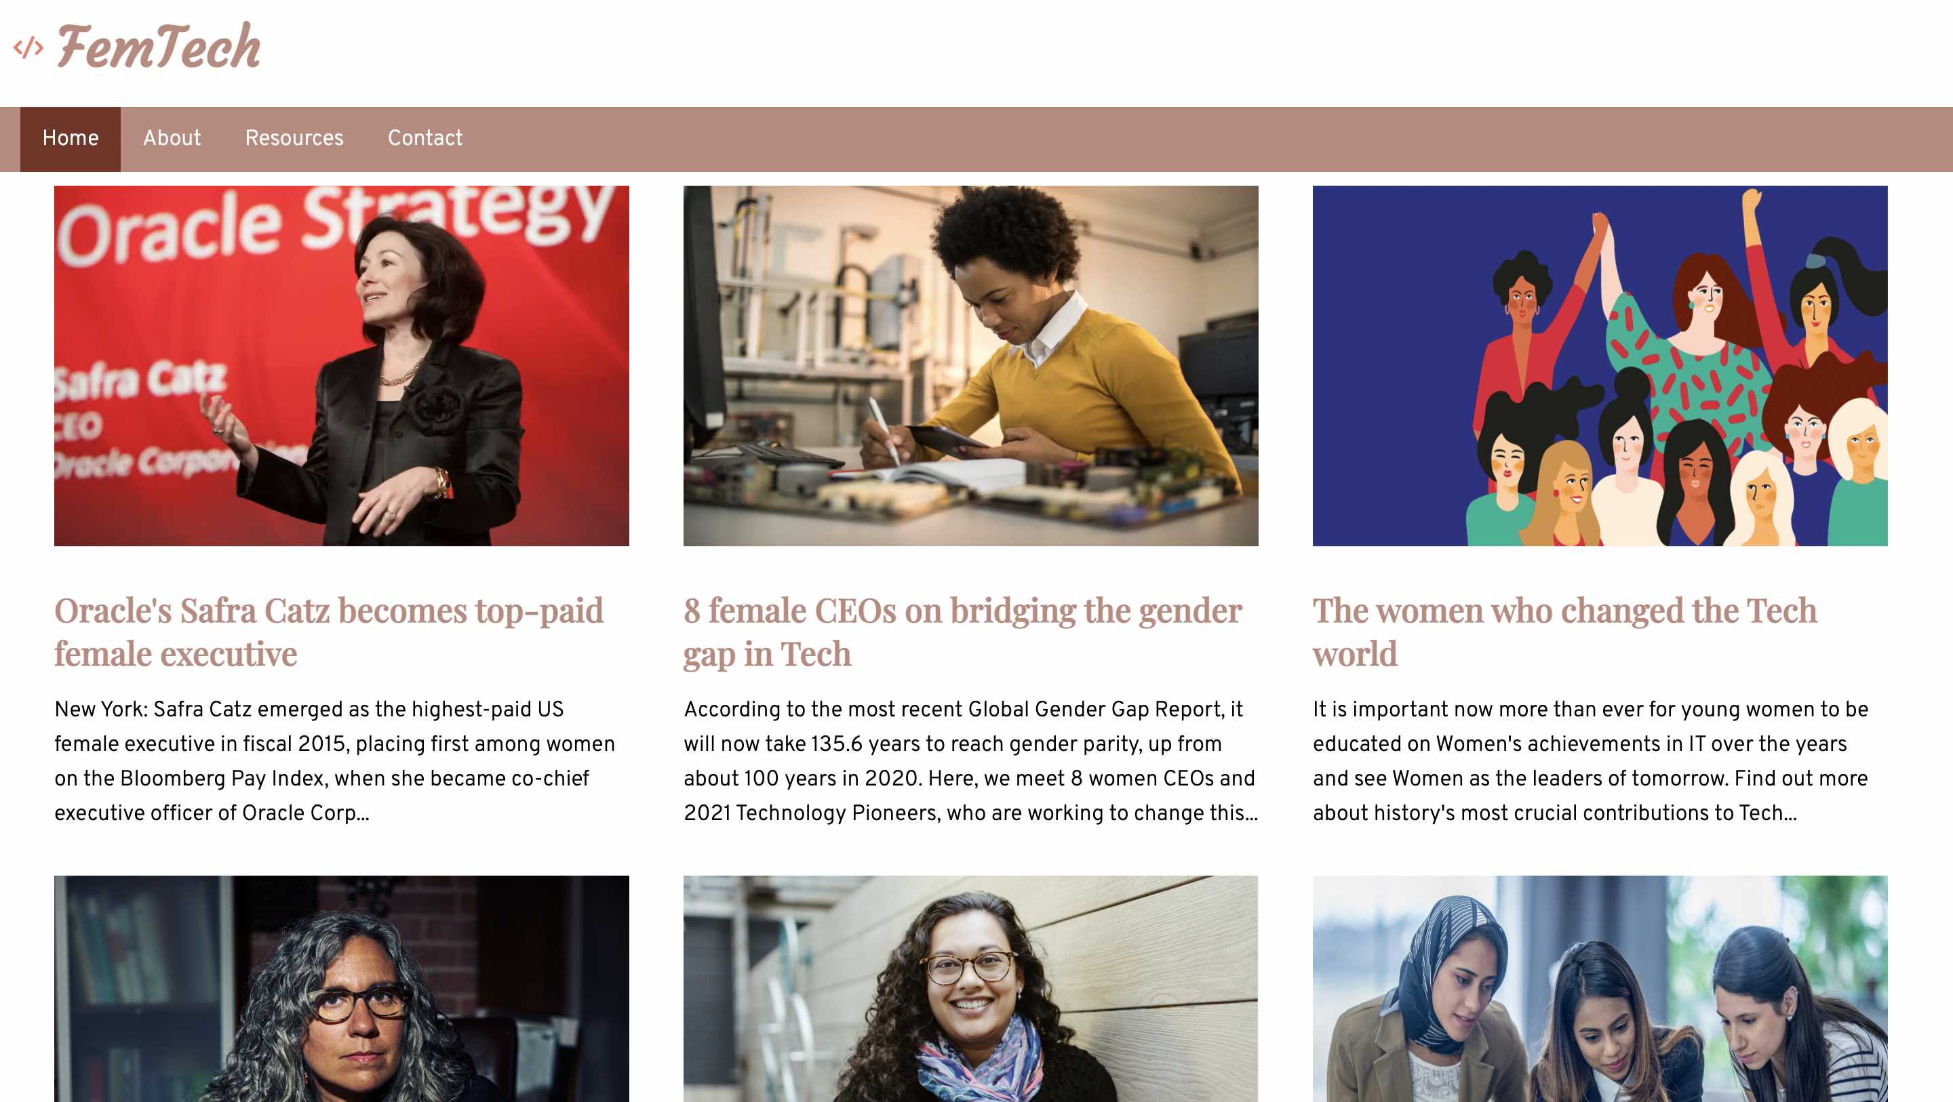
The Website: FemTech
The website will gather informative news articles, portraits and interviews regarding women in tech.
It will also provide partners resources to advance in Tech but also community support.

